Slide 1


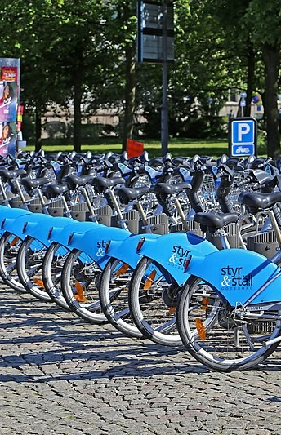



Bike Sharing Demand Prediction
z
Group Members :
Shivaji Reddy Sama (F454W858)
Gnana Deepika Pathuri (Z446J657)
Krishna Sai Bharadwaj Ramavarapu (C762F342)
Kishore Poojari (G397M563)
Sandeep Reddy Nimmala (G774X852)
Avinash Ragi (N765Q235)
Yeshwanth Yellanki (P677G233)

Slide 2
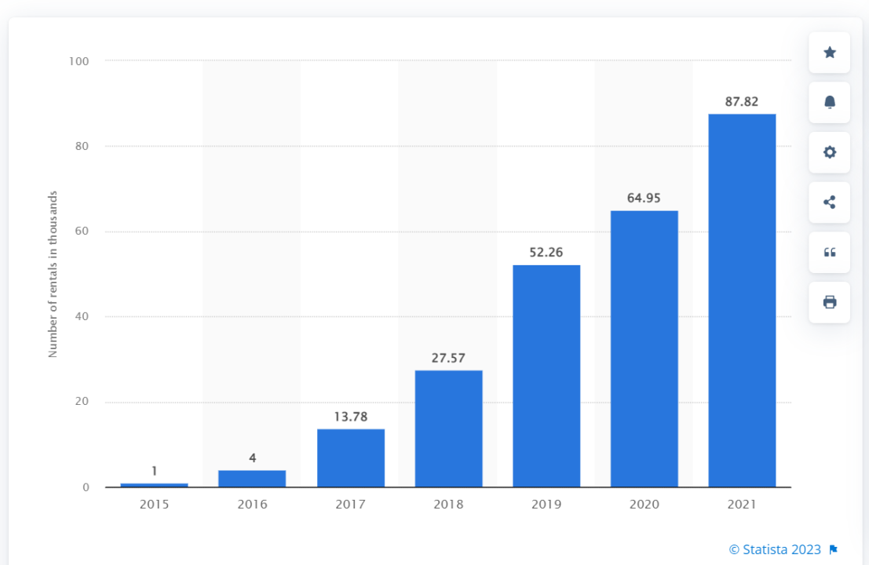
INTRODUCTION
Seoul Bike (Ddareungi) is a public bicycle rental service run by the Seoul Metropolitan Government, aimed at reducing traffic congestion and greenhouse gas emissions.
Around 88,000 bikes were rented out by people in Seoul in 2021, up from roughly 65 thousand the year before. The tariff has climbed by more than thrice yearly since the program began in 2015
Average daily number of Seoul Bike rentals in South Korea from 2015 to 2021
Notes:
Seoul city is capital of south korea. In seoul city there is a bike sharing program named ddareungi the interesting thing about the bike sharing program is

Slide 3
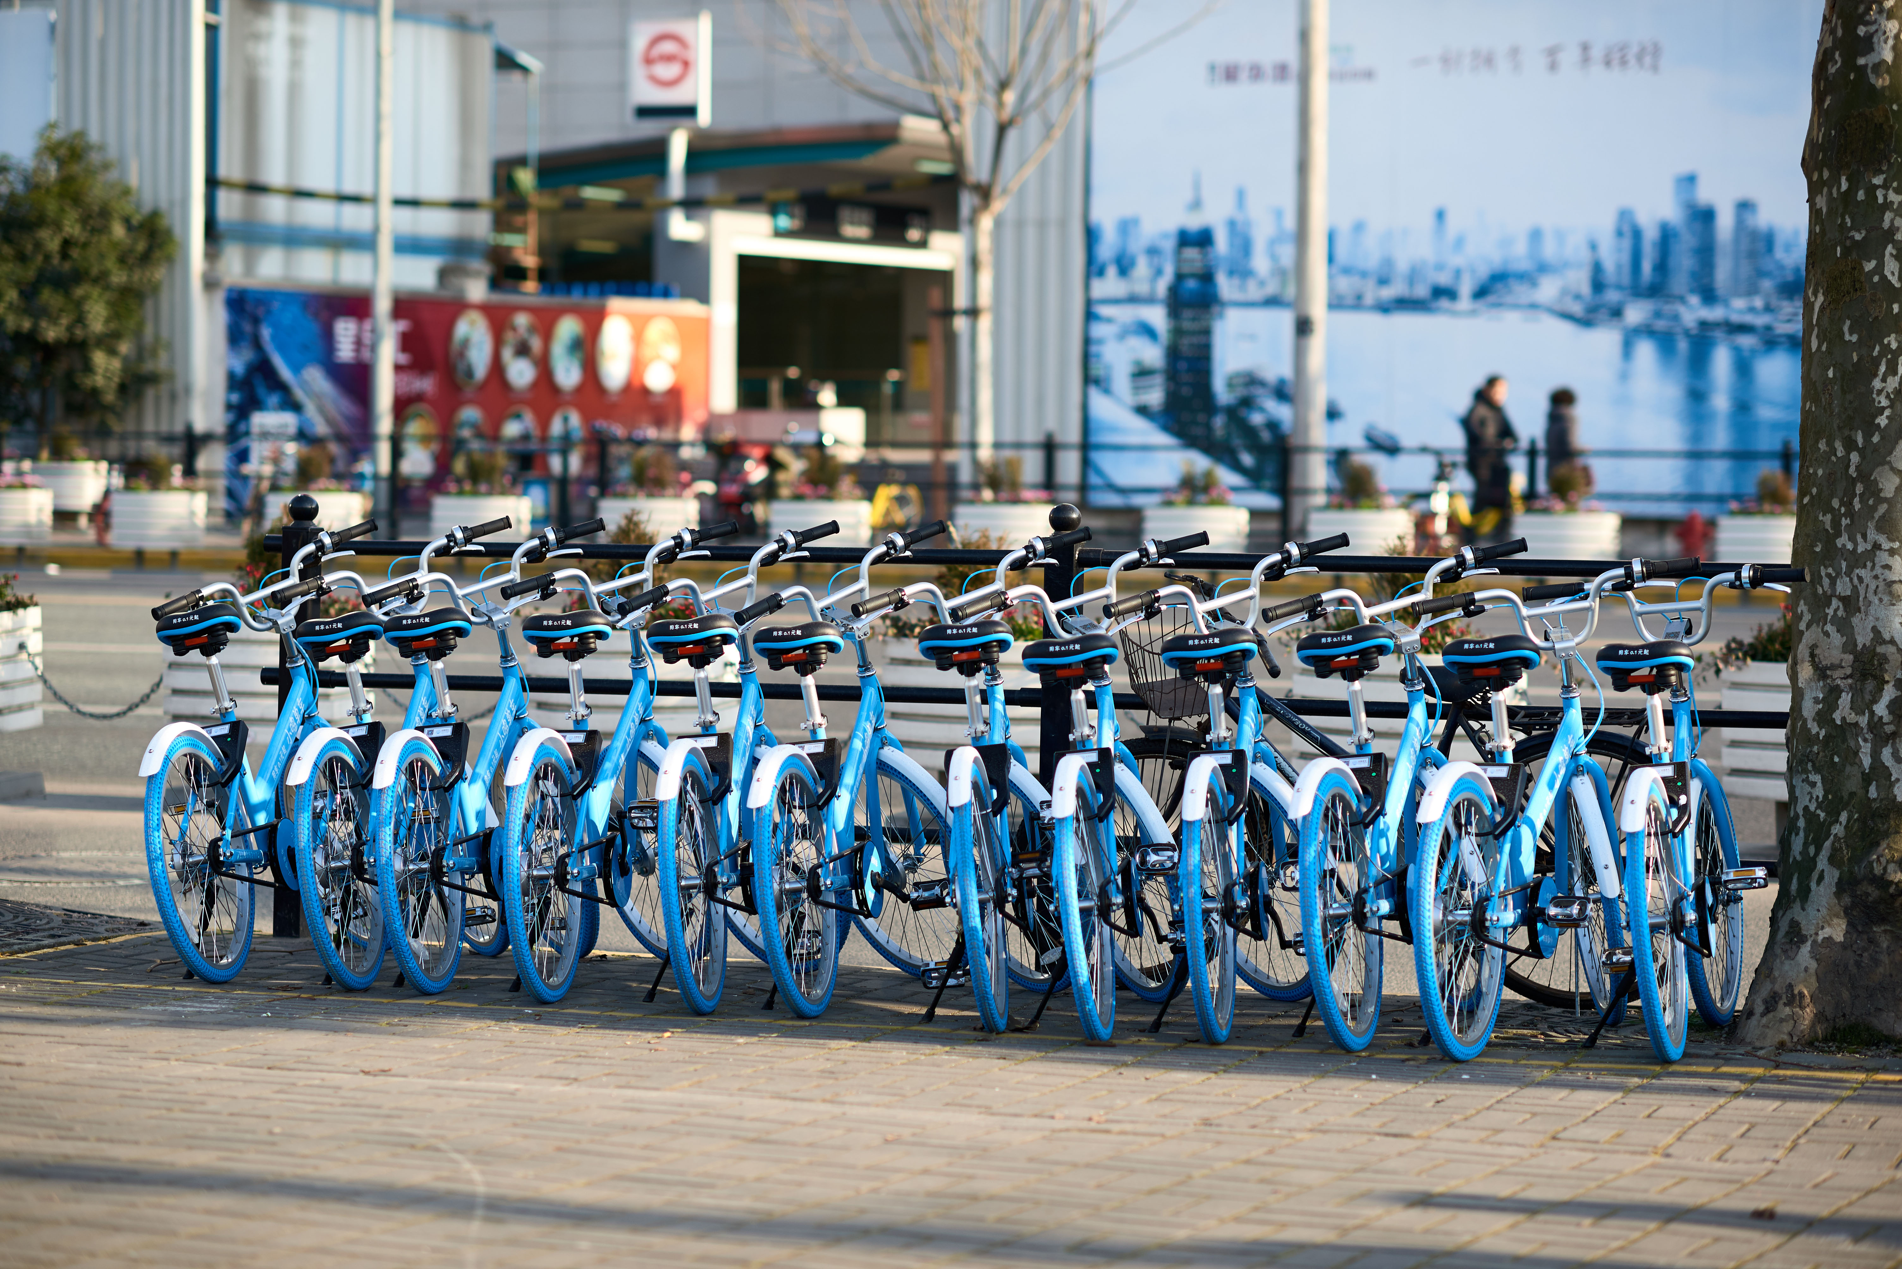
INTRODUCTION
Bike-sharing system is a shared transport service that provide bicycles for shared use.
Rental stations are located throughout the city, allowing anyone to rent a bicycle, ride it for a short distance, and return it to any station within the city.
Maintaining a steady supply of rental bikes has become a top priority due to increased demand, and making rental bikes easily accessible to the public at the right time can reduce waiting times.
Predicting the number of bikes needed to maintain a steady supply at each hour interval is crucial.
Notes:
But what are bike sharing systems?
Bike-sharing system is a shared transport service that provide bicycles for shared use.
So how the system works is
If a person wants to go from place a to b, ppl go to rental station, rent the bike, ride for short distance and return to station
The key things here is Maintaining a steady supply of rental bikes Predicting the number of bikes needed to maintain a steady supply at each hour interval is crucial.

Slide 4
BACKGROUND
Key factors affecting bike-sharing demand: User characteristics (age, gender, income, trip purpose), environmental factors (weather, time of day, day of the week, season), and contextual variables (bike availability, infrastructure, pricing, policies).
Impact of weather conditions: Research has shown significant influence of temperature, humidity, and precipitation on bike-sharing usage patterns (Gebhart and Noland, 2014; Faghih-Imani et al., 2017).
Role of time factors: Bike-sharing demand is higher during weekdays and peak commuting hours, as well as in warmer months (El-Assi et al., 2017; Chen et al., 2016).
Importance of user characteristics: Higher-income individuals and younger adults are more likely to use bike-sharing systems, with different usage patterns for commuting and leisure trips (Fishman et al., 2014; Wang et al., 2019).
Contextual variables: Availability of bikes and docking stations, infrastructure quality, pricing schemes, and local policies can significantly affect bike-sharing demand (Romanillos et al., 2016).

Slide 5
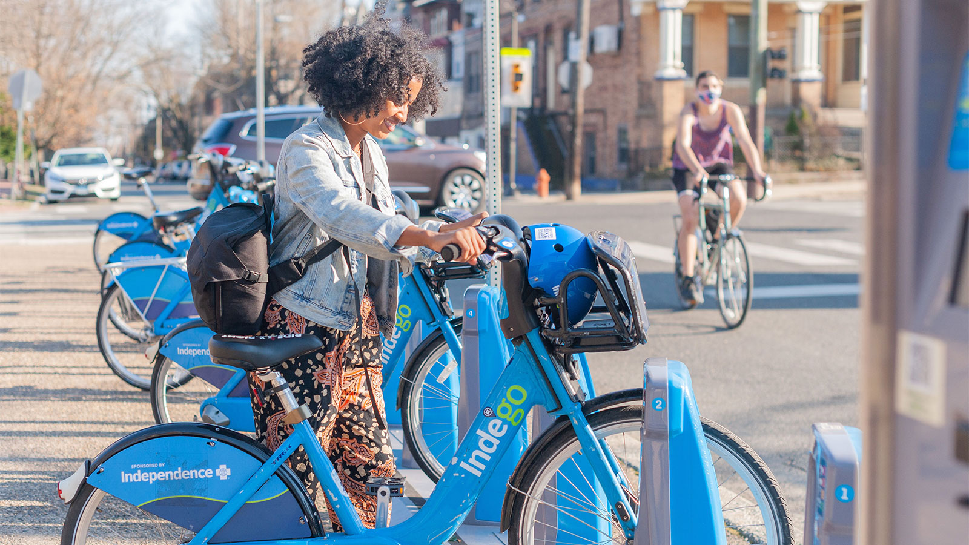
HYPOTHESIS
Higher temperatures lead to an increase in bike rentals.
Bike rentals are more frequent in the early morning and evening.
Bike rentals will be low on weekends compared to weekdays.

Slide 6

RESEARCH QUESTIONS
Which model can better predict the hourly demand for bikes in Seoul using historical data and environmental factors out of OLS, Decision Tree Regressor, Random Forest ?
How accurately can we predict the hourly demand for bikes in Seoul using historical data and environmental factors ?
What are the 3 most important features for bike demand prediction ?

Slide 7
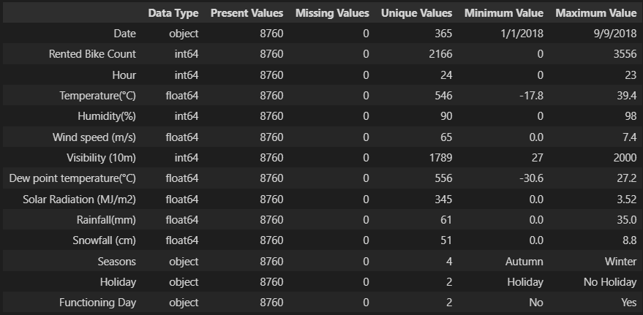
METHODOLOGY
Dataset :
The dataset comprises 14 attributes and 8760 instances. It contains weather-related details, bike rental counts per hour, along with date information.
Each group of 24 instances represents a day of the year, and the primary objective is to use this dataset to forecast the number of bikes rented per hour.
Data Cleaning:
No duplicate, null, or missing values in the dataset.
However, we observed that some columns exhibited significant skewness. Therefore, we have applied power transformation technique to standardize the data.
As part of data cleaning, we have removed variables such as Functioning day because it is redundant and Dew point temperature, since it is highly correlated with Temperature variable.

Slide 8
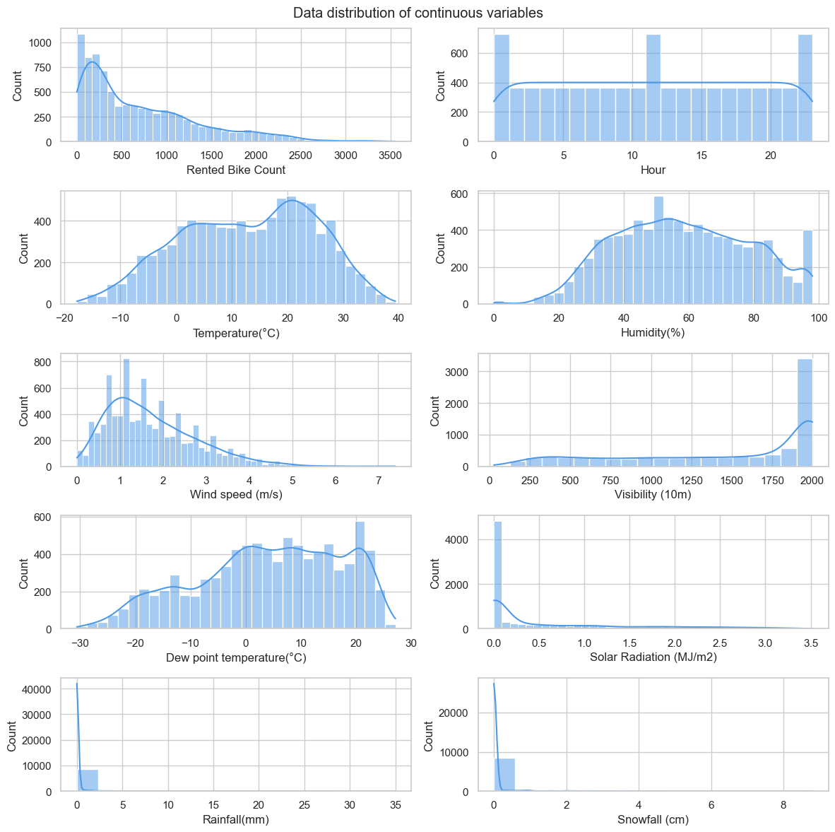
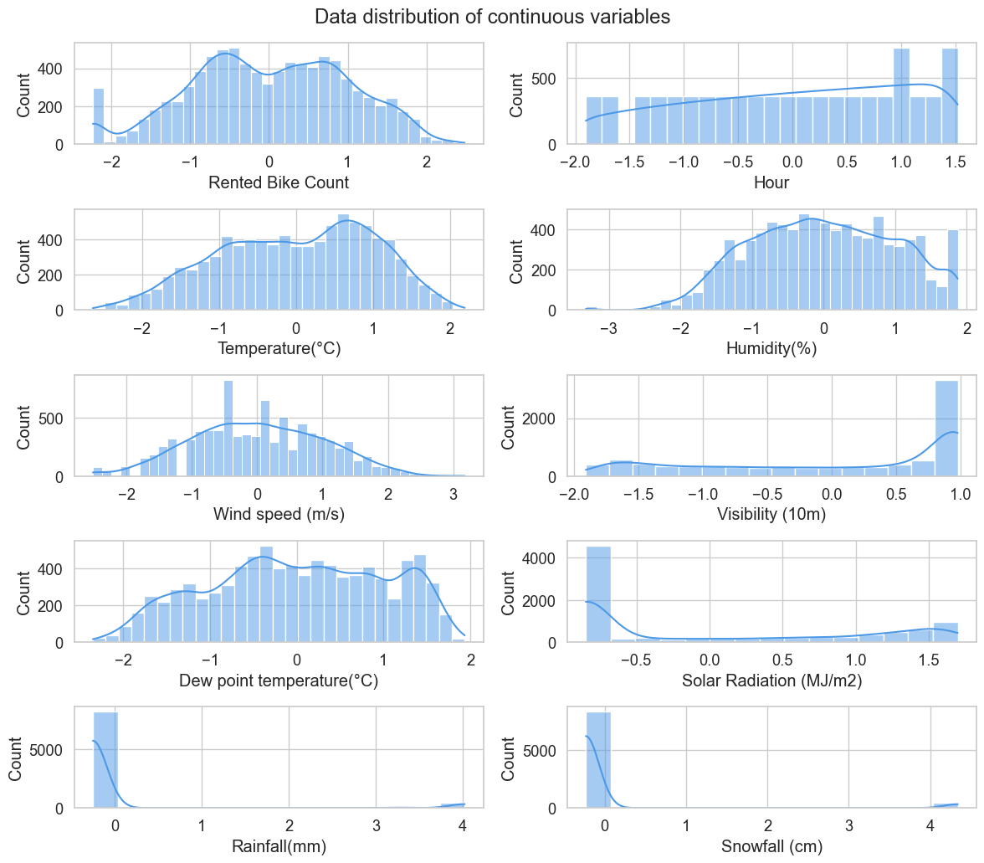
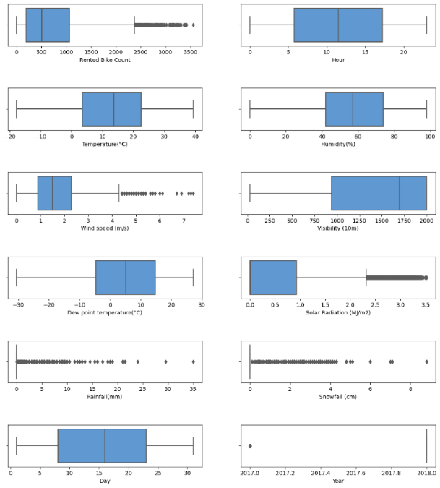
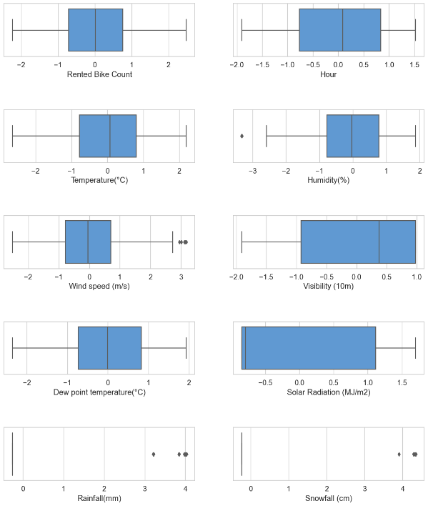
Data Transformation :
Upon applying power transformation technique, the data appears to be mostly normally distributed, as evidenced by the before and after transformation figures.
Before Transformation
After Transformation
The box plot analysis revealed the presence of outliers in variables such as Rented Bike Count, Solar Radiation, Wind Speed, Rainfall, and Snowfall. However, after applying the power transformation technique, the outliers have reduced significantly, as evident from the box plots.
Outliers Before Transformation
Outliers After Transformation

Slide 9
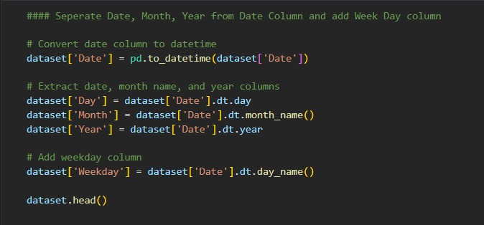
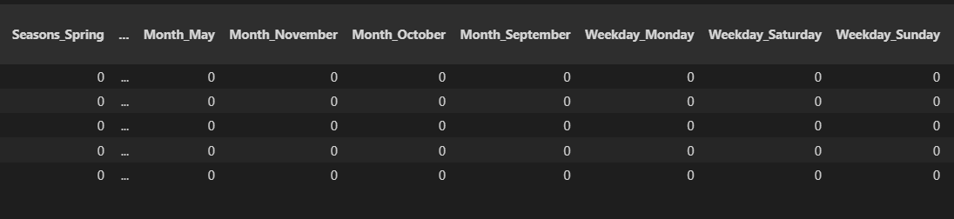
Fig 5: extracting date features of Date variable
Feature Engineering:
Extracting date features technique on Date variable and created new features such as Day, month, Year and Weekday.
Fig : extracting date features of Date variable
one-hot encoding technique to create dummy variables for the categorical variables such as Months, Seasons and Holiday features.
Fig : One-hot encoding categorical variables

Slide 10
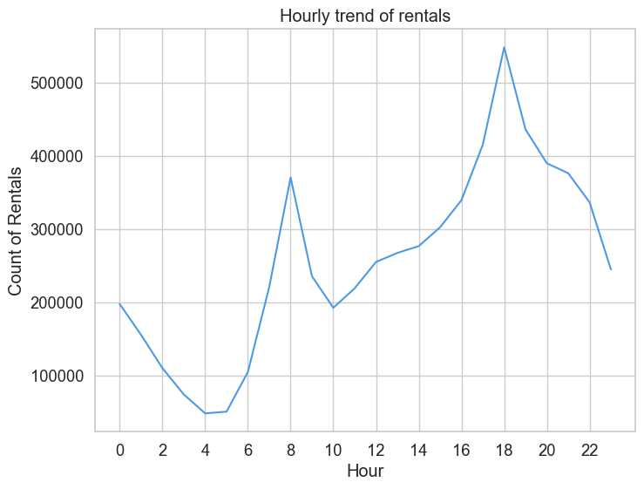
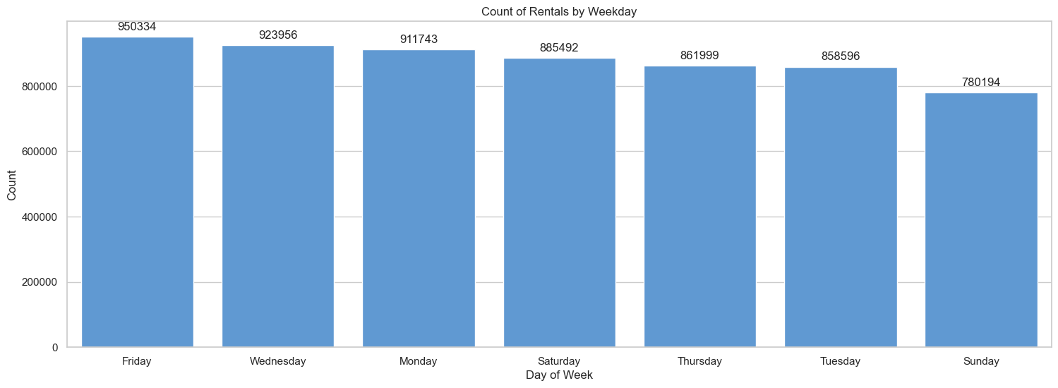
Data Visualizations
Count Vs Hours :
The highest number of rented bikes occurs during the evening rush hour, specifically at 6 PM and 5 PM (office hours).
The morning rush hour, particularly at 8 AM and 7 AM also sees a significant number of bike rentals.
Count Vs Weekdays :
The highest count of rented bikes occurs on Friday and Wednesday(On most working days)
While the least count occurs on Sunday. ( No offices/work)

Slide 11
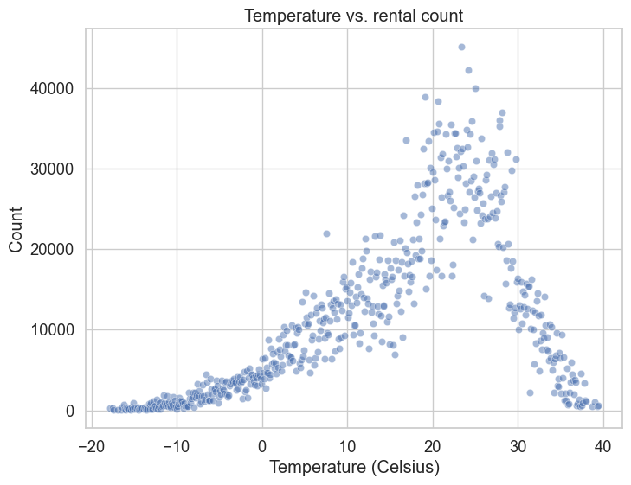
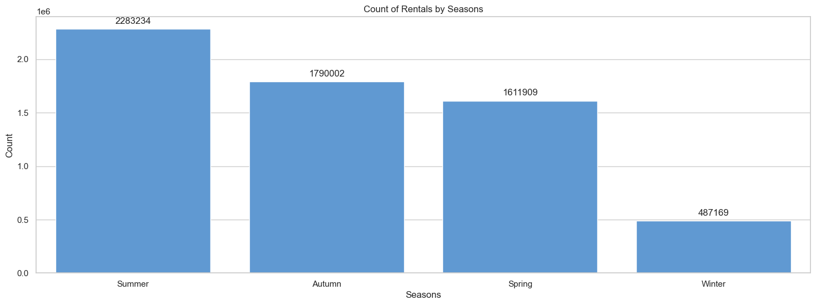
Count Vs Temperature :
The scatter plot exhibits an upward trend, which suggests that warmer weather increases the demand for bike rentals.
The ideal temperature range for bike rentals is between 20 and 30 degrees Celsius.
Count Vs Seasons :
The The highest count of rented bikes occurs in summer, while the least occurs in winter.

Slide 12
Model Evaluation
The random forest model outperforms both the decision tree and OLS models in terms of R-squared score, MSE, and RMSE.
The decision tree model performs slightly better than the OLS model, but its performance is still moderate.
The OLS model has the lowest performance among the three models, indicating that it might not be suitable for this dataset or problem.

Slide 13
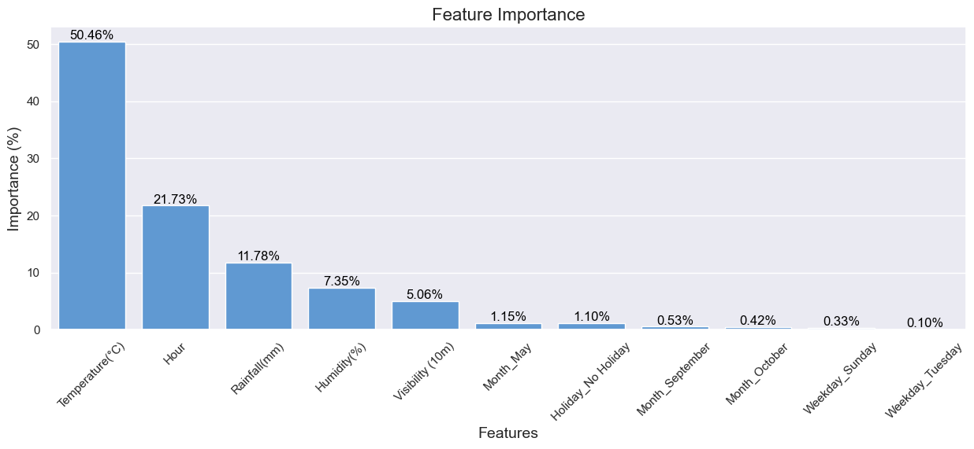
FEATURE IMPORTANCE
The most significant characteristic is temperature (50.46%). This suggests that it is quite important in figuring out how people use bikes. People are more inclined to rent bikes when the temperature rises.
The relevance of the time of day is ranked second (21.73%). The demand for bicycles varies throughout the day, peaking in the morning and evening while people are commuting and declining in the off-peak periods.
Rainfall has the third-highest feature importance (11.78%). Increased rainfall is likely to discourage people from renting bikes, resulting in a negative relationship between rainfall and bike usage.

Slide 14
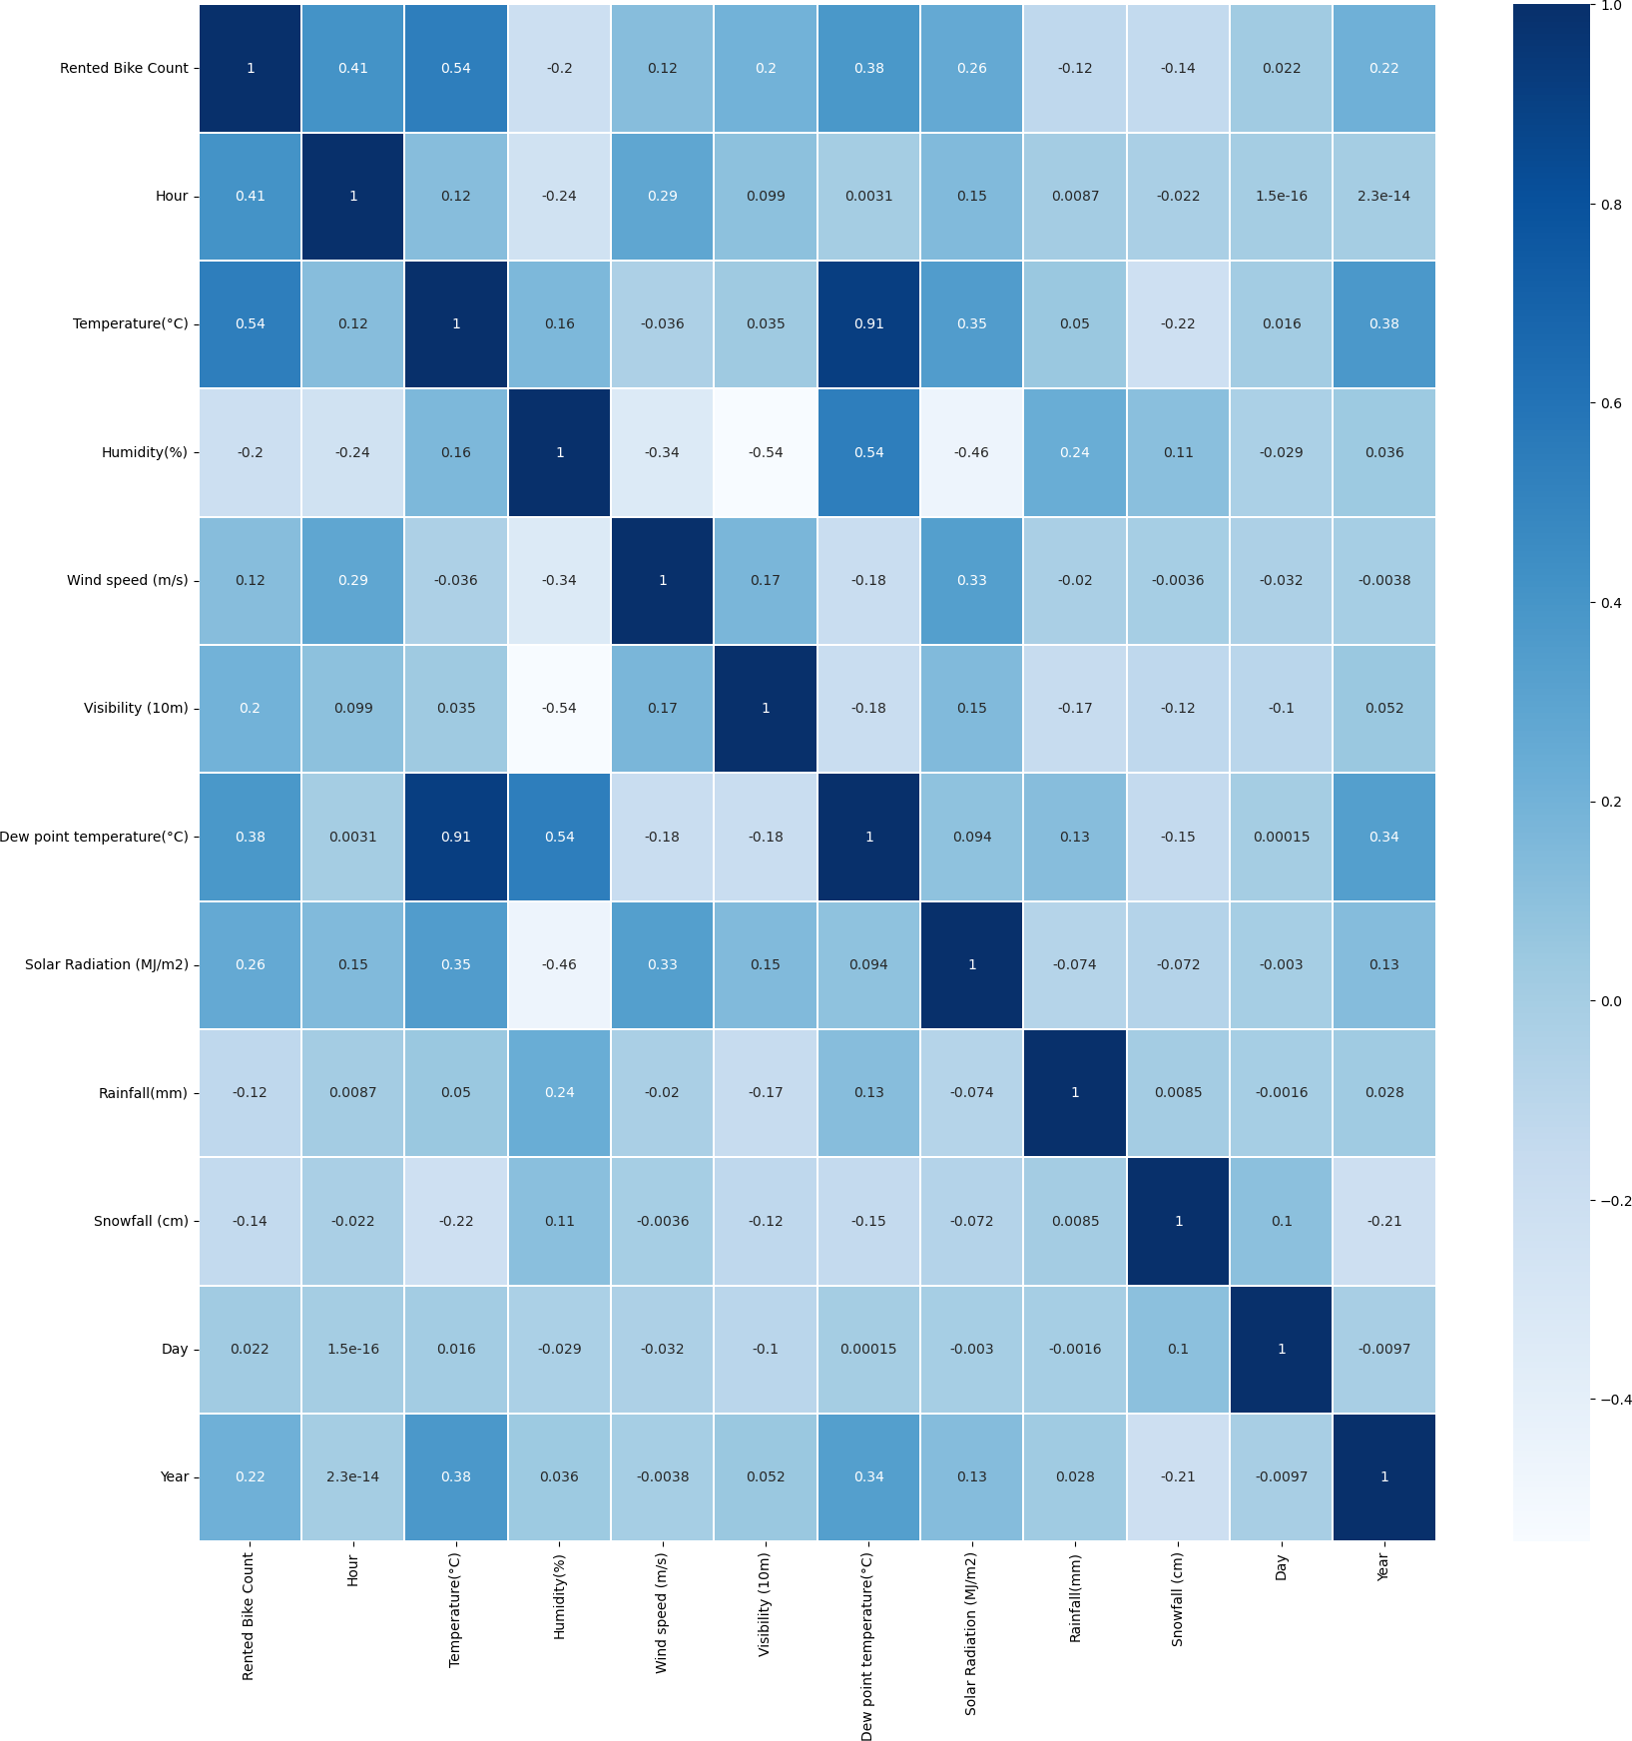
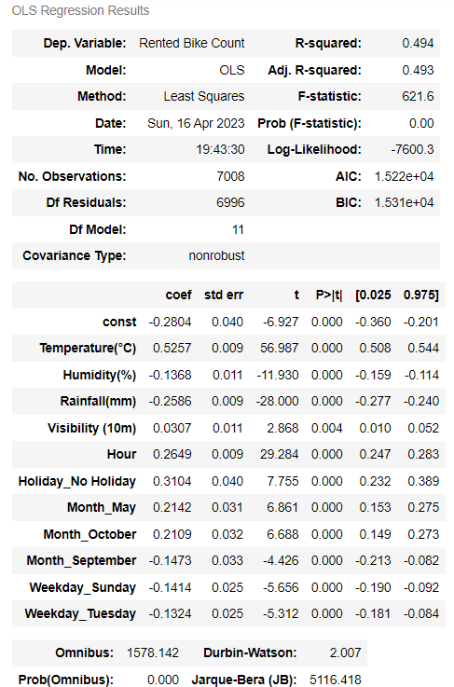
FINDINGS
Three hypotheses are supported
Hypothesis: Higher temperatures lead to an increase in bike rentals.
The correlation matrix shows a positive correlation between the Rented Bike Count and Temperature(°C) (0.538558), and the OLS regression results also support this hypothesis, as the coefficient for Temperature(°C) is positive (0.5257).
Hypothesis: Bike rentals are more frequent in the early morning and evening.
The Hour variable has a significant positive coefficient (0.2649) in the OLS regression results, and the distribution of bike rentals by hour also shows a trend, with peak hours being 8 am, 6 pm, 7 pm
Hypothesis: Bike rentals will be low on weekend compared to weekdays.
Friday having the highest count and Sunday the lowest. The OLS regression results also show significant negative coefficients for Weekday_Sunday (-0.1414) compared to other days in the week.

Slide 15
FINDINGS
1. Which model can better predict the hourly demand for bikes in Seoul using historical data and environmental factors out of OLS, Decision Tree, Random Forest ?
The random forest model outperforms both the decision tree and OLS models in terms of R-squared score, MSE, and RMSE
2. How accurately can we predict the hourly demand for bikes in Seoul using historical data and environmental factors ?
Using the Random Forest Regressor Model, we can predict the hourly demand for bikes in Seoul with 76% Accuracy.
3.What are the 3 most important features for bike demand prediction ?
Temperature has the highest feature importance (50.46%), Hour: Time of day has the second-highest feature importance (21.73%) and Rainfall has the third-highest feature importance (11.78%).

Slide 16
RECOMMENDATIONS
Future research can address the limitations of this study and improve understanding of bike-sharing demand by incorporating additional variables such as bike lane availability, local culture, and public transportation options.
Expanding the analysis to include data from multiple cities and time periods can enhance the generalizability of the findings.
Researchers should experiment with various machine learning algorithms and data preprocessing techniques to improve the accuracy and robustness of the predictive models.
By addressing these issues, future research can provide more comprehensive insights into bike-sharing demand and help inform policymakers and bike-sharing service providers.

Slide 17
REFERENCES
El-Assi, W., Salah Mahmoud, M., & Habib, K. N. (2017). Effects of built environment and weather on bike sharing demand: a station level analysis of commercial bike sharing in Toronto. Transportation, 44(3), 589-613. Retrieved from https://link.springer.com/article/10.1007/s11116-015-9669-z
Gebhart, K., & Noland, R. B. (2014). The impact of weather conditions on bikeshare trips in Washington, D.C. Transportation, 41(6), 1205-1225. Retrieved from https://link.springer.com/article/10.1007/s11116-014-9539-8
Fishman, E., Washington, S., & Haworth, N. (2014). Bike Share’s impact on car use: Evidence from the United States, Great Britain, and Australia. Transportation Research Part D: Transport and Environment, 31, 13-20. Retrieved from https://www.sciencedirect.com/science/article/pii/S1361920914000802
Romanillos, G., Zaltz Austwick, M., Ettema, D., & De Kruijf, J. (2016). Big data and cycling. Transport Reviews, 36(1), 114-133. Retrieved from https://www.tandfonline.com/doi/full/10.1080/01441647.2015.1069901

Slide 18


